Slide 1
Please insert the logo of your institution here
FIRST RWANDA STI CONFERENCE
At KCC 31st March-1st April 2022
Please insert the Title of the Presentation
By: Please insert the presenter names and Position
Leveraging the Potential of Science and Technology to Mitigate Challenges Associated with Covid-19 Pandemic in Developing Countries

Slide 2
PPTS/ Slides Guidelines
Tile font size and Style ( Bold, 44, Arial)
Text should be size 24 and Arial
Make sure that images used or figure are clear and visible
Please note that PPTs is not word document try to be brief and use figure when necessary
Please practice/rehearse is need before presentation in front of your colleagues or yourself to make sure that you will keep the time
You have 15 min for presentation and 5 min for Q&A
Max 20 slides including everything are enough . You can spent 1 min on each slide having your results.
Always cite and make the source of something which is not yours

Slide 3
Presentation Outline
Project Background
Relevance and Novelty of the Study
Objectives
Results and Discussion
Impact to the society
Conclusions

Slide 4
Relevance and Novelty of the Study
Please try to show the gap in the field and what you try to solve using STI. Please try to be brief and use data to support your projects.
Remember that a PPT presentation should have a lot figures and make sure to put source of your data if they are from this study.
Make sure that you have clear image or figure so that everyone can read it easily

Slide 5
Aim and Objectives
Cite the aim and the objective of your study which are relevant to the theme of our conference;
Deliberate on innovative strategies
Examine existing data
Create opportunity for scientific progress
Harmonize strategy for future scientific dialogue
Shape sustainable strategies on R&D technology tools

Slide 6
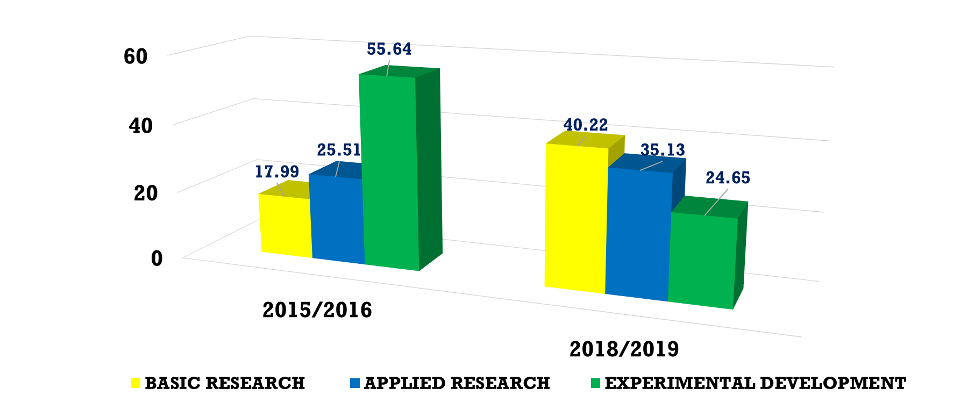
Results and Discussion
An example of how the figure should be

Slide 7
Impact to the society Brief summary the contribution to health field and policy
Show the importance of your project to the society
Brief summary the contribution to health field and policy

Slide 8
Conclusions Impact to the society
Please show the concluding results of your study, what are the key findings
Brief summary of what you discovered based on results
Indicate and explain whether or not the data supports your hypothesis

Slide 9
References Impact to the society
Please try to be consistent ; if you are using Harvard style keep it for all.

Slide 10
Acknowledgment Impact to the society
Please note that it is always good to acknowledge people who support you for the success of this project
Funder, data provider, e.t.c

Slide 11
Thank you!

